Slide 1
Starters
Week 31

Slide 2
Starter: Monday
Week 31
WORK
PBS - WRITING
Showing your work, find the circumference (area) of the following:
Body Language
Body language can include: facial expressions, eye behavior, gestures, posture, and more.
Give ONE example of how your posture in class communicates to your teachers that you are ready to learn.
Example:
My body language lets my teacher know I’m ready to learn because…..
Diameter = 24 in.
OBJECTIVE:
Agenda:

Slide 3

Starter: Tuesday
Week 31
WORK
PBS - WRITING
Error analysis: Find what the student did wrong by showing how they should have found the area:
Communicating
We all communicate differently with different people in our lives.
Does the way you communicate (or say things) affect how others perceive you? Why or why not?
Example:
The way I communicate (does/does not) affect how others perceive me because…..
Diameter= 16 in.
$A=πr^{2}$
A = 3.14 (16in. x 16in.)
A = 3.14 (256)
A = 803.84 in.
OBJECTIVE:
Agenda:

Slide 4
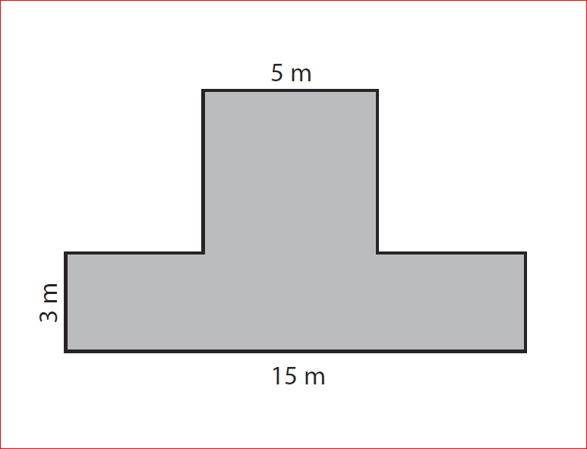
Starter: Wednesday
Week 31
WORK
PBS - WRITING
Decompose the following irregular polygon into TWO figures, then find the area of each one.
“Teamwork divides the task and multiplies the success”
What does this quote mean to you and how has it applied to our Math class?
OBJECTIVE:
Agenda:

Slide 5
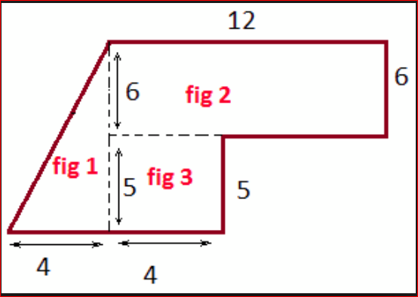
Starter: Thursday
Week 31
WORK
PBS - WRITING
An irregular polygon has been decomposed into THREE figures. Find the TOTAL area using “ft.” as your units:
Perseverance
“The road to success is paved with failure”
How does failing or not succeeding at something apply to your being successful in your academics?
OBJECTIVE:
Agenda:

Slide 6
Starter: Friday
Week 31
WORK
PBS - WRITING
When finding the area of the triangle (figure 1), a student got a total of 44${ft.}^{2}.$ What did the student forget to do and what should the area of the triangle be? (Show your work)
Attitude
What is a “positive attitude” to you?
If you have a positive attitude, what actions might you display?
A positive attitude to me means…..
If I have a positive attitude, the actions I might display are…..
Agenda:
OBJECTIVE:

